Slide 1

Psalm 1

Slide 2
How many Psalms?
Asaph
150
David
Ethan
Moses
Jeduthun
Solomon

Slide 3

Sorry, I forgot one
Heman
Only mentioned as the writer of Psalm 88 – nothing else!

Slide 4
Psalm 1 – verse 1
Blessed is the man
Who walks not in the counsel of the ungodly,
Nor stands in the path of sinners,
Nor sits in the seat of the scornful;

Slide 5
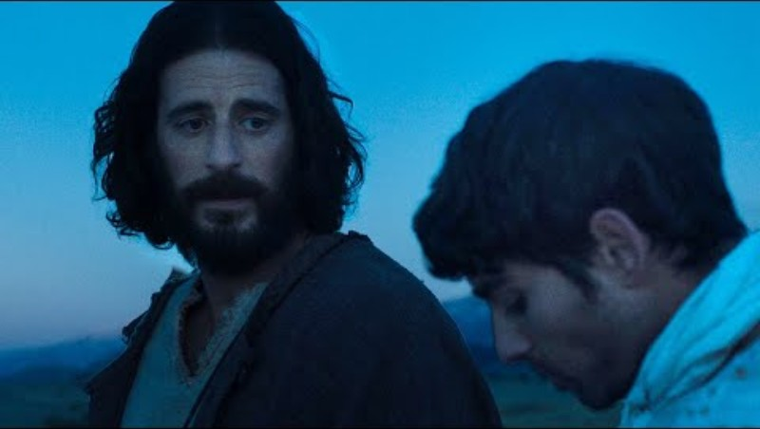

Slide 6
Psalm 1 – verse 2
But his delight is in the law of the Lord,
And in His law he meditates day and night.

Slide 7
Psalm 1 – verse 3
He shall be like a tree
Planted by the rivers of water,
That brings forth its fruit in its season,
Whose leaf also shall not wither;
And whatever he does shall prosper.

Slide 8
Psalm 1 – verse 4
The ungodly are not so,
But are like the chaff which the wind drives away.

Slide 9
Psalm 1 – verse 5
Therefore the ungodly shall not stand in the judgment,
Nor sinners in the congregation of the righteous.

Slide 10
Psalm 1 – verse 6
For the Lord knows the way of the righteous,
But the way of the ungodly shall perish.

Slide 11

Two Paths

Slide 12
Conclusion
1 down, 149 to go !!!
Psalm 1 – 6 verses, go meditate!
Mike up next – Psalm 2 (are you sure we are not doing 150?)
Then Alan G with our ‘favourite’ psalm.

